Slide 1
POSITIONING BROKEN ARROW FOR THE FUTURE: VERDIGRIS RIVER WATER TREATMENT PLANT AND WATER SUPPLY SYSTEM IMPROVEMENTS
Where opportunity lives
Spring 2013
Notes:
Imagine

Slide 2
Presentation Overview
Part I – Introduction
Mission Statement
Historical Background
Water Supply Master Plan
Water Facility Improvements
Water Supply System Improvements
Water Supply System Overview
Part II – Disinfection
Regulatory Agencies and Laws
Disinfection Regulations
Disinfection
Disinfection Byproducts
Advantages And Disadvantages
Questions and Answers
Conclusions

Slide 3
Introduction
Part I
Water Supply System:
Introduction

Slide 4
Mission Statement
Purpose
The purpose of this presentation is to provide the general public with a basic understanding of the City of Broken Arrow water supply system and accurate, scientific-based evidence and information concerning the history, process and use of chloramination as a secondary disinfection technique for drinking water in a public water system.
Goal
The goal of this presentation is to demonstrate to the City of Broken Arrow water customers that chloramination is a safe, effective, and efficient secondary disinfection technique.

Slide 5
Historical Background
Safe Drinking Water
Since beginning of civilization, safe drinking water has been a critical concern for all humankind.
Waterborne pathogens have killed countless number of people throughout human history.
Disease causing organisms enter water through animal and human waste.
As human population began to increase and develop large cities, waterborne outbreaks became commonplace.
During the Industrial Revolution, major urban areas worldwide became plagued with waterborne epidemics.

Slide 6
Historical Background
Safe Drinking Water (Since 1800s)
During the 1800s, two major environmental engineering technological advancements became common practice in major urban areas.
Water Treatment Facilities
Wastewater Treatment Facilities
However, poor sanitation and lack of water disinfection practices allowed waterborne epidemics to persist.
By the early 1900s, the major urbanized countries of the world had all but eradicated most of the known waterborne epidemics by the practice of disinfection.
In the early 1970s, scientists discovered disinfection byproducts (DBPs) directly caused by to the chlorination process.

Slide 7
Historical Background
Broken Arrow Water Supply (1902-1960)
The original water supply for the newly founded community came from fresh water springs located four to five miles south of town along the Broken Arrow Creek and Elm Creek watersheds.
In 1909, the residents of Broken Arrow approved a bond election to construct the first water supply system for the community. The system consisted of an 8-inch diameter line that pumped water from the springs south of town to the community. The original capacity of the system was 0.5 million gallons of water per day (MGD).
In 1954, the City drilled a group of groundwater wells within the floodplain region of the Arkansas River. This additional water was pumped from these wells to a water tower located in downtown.

Slide 8
Historical Background
Broken Arrow Water Supply (1960-Present)
In 1966-1967, the City established the present-day Verdigris River Water Treatment Facility. This system pumped raw water from the Verdigris River uphill to a reservoir. The water was treated through conventional sand filtration process. The original capacity of the plant was 4 million gallons per day (MGD).
In 1975, the City expanded the Verdigris River Water Treatment facility from 4 MGD to 10 MGD due to the tremendous growth the community began to experience in the late 1960s and the early 1970s.
In 1982, the City began to purchase treated water from the Oklahoma Ordnance Works Authority (OOWA) located near Pryor, Oklahoma. Contract terms provided up to 27 MGD for a 31 year period. Contract was set to expire December 31, 2012.
May 17, 2011, City Council agreed to an extension to December 31, 2013 of the current OOWA water purchase contract.

Slide 9
Water Supply Master Plan
Long Range Water Supply Committee
February 16, 2004, the City Council established the Long Range Water Supply Committee with the purpose of studying the community’s current water supply system, developing and analyzing potential alternatives and making recommendations to the water supply system in order to examine a long-range (50 year) planning horizon.
Committee included members from the City of Broken Arrow staff as well as from the residents and water customers within the community as a whole.
March 6, 2006, the City Council adopts by formal action the recommendation from the Long Range Water Supply Committee which was to re-negotiate a purchase water contract with OOWA that would provide up to 20 million gallons of water per day (MGD) and expand the City water treatment facility on the Verdigris River to produce up to 30 million gallons of water per day.

Slide 10
Water Supply Master Plan
Water Supply Master Plan Development
April 2, 2007, the City Council enters into an Agreement with HDR Engineering, Inc. in order to evaluate, investigate and develop a Water Supply Master Plan that implements the recommendations of the Long Range Water Supply Committee.
March 18, 2008, the Plan Development Report which develops a working Water Supply Master Plan for the community was presented to Broken Arrow Municipal Authority. The Master Plan investigates and examines the following critical issues out to the year 2060:
Water Demand Projections;
Raw Water Storage and Reserve Capacity;
Source Water Quality and Treatability; and
Water Treatment Process Alternatives and Conceptual Design

Slide 11
Water Supply Master Plan
Water Supply Master Plan Recommendations
Phase I Recommendations to 2028
Rehabilitate raw water intake structure
New raw water supply line to reservoir
New 150 MG reservoir
New 15 MGD membrane treatment facility
Convert Secondary Disinfection from Free Chlorine to Chloramines to reduce disinfection byproduct formation potential
New 4-MG clearwell
New high service pump station
Phase II Recommendations to 2060
Rehabilitate raw water intake structure
New additional 150 MG raw water reservoir
Expand high service pump station equipment
New finished water supply line to the distribution system

Slide 12
Water Facility Improvements
Water Source Confirmation Testing
June 17, 2008, City Council entered into an Agreement with HDR Engineering, Inc. to perform extensive pilot testing of the source water in order to determine the best water treatment and secondary disinfection process based upon our specific water quality.
The Membrane Filtration Pilot Study concluded that microfiltration through a membrane was a good treatment process specifically suited for the City of Broken Arrow source water, the Verdigris River.
October 1, 2009, Membrane Filtration Pilot Study Report was sent to Oklahoma Department of Environmental Quality for approval from the State of Oklahoma governing agency.
April 24, 2010, Oklahoma Department of Environmental Quality approves the Membrane Filtration Pilot Study.

Slide 13
Water Facility Improvements
Verdigris River Water Treatment Facility
September 15, 2009, the City Council/BAMA enters into an Agreement with HDR Engineering, Inc. to provide consulting services for the design of a new membrane water treatment facility.
August 19, 2011, State of Oklahoma Department of Environmental Quality (ODEQ) approves the Engineering Report that details the proposed new membrane filtration treatment process and conversion from chlorination to chloramination for the secondary disinfection process.
October 14, 2011, State of Oklahoma Department of Environmental Quality (ODEQ) grants the Permit to Construct a new 20 MGD Membrane Filtration water treatment facility using the Verdigris River for a water source and conversion to chloramination for secondary disinfection.

Slide 14
Water Facility Improvements
Verdigris River Water Treatment Facility
March 5, 2012, the City of Broken Arrow enters into a construction contract in the amount of 56.8 million dollars for the construction of the new water treatment facility.
July 2013, Phase I construction scheduled to be complete.
July 2014, Phase II construction scheduled to be complete.

Slide 15
Water Supply System Improvements
Supplemental Water Supply
August 24, 2010, since new supplemental Agreement with OOWA could not be reached on terms satisfactory to either party, the decision was made to enter into an Agreement with the Tulsa Metropolitan Utility Authority (TMUA) for a supplemental water supply to provide a secondary water source.
January 26, 2011, the Broken Arrow Municipal Authority (BAMA) enters into a 40-year Agreement with TMUA to supply supplemental water up to a maximum of 20 million gallons per day (MGD) effective January 1, 2013. Agreement expires December 31, 2053.
December 17, 2012, construction of the new 24-inch diameter water supply connection began. Schedule to be complete mid-April 2013.

Slide 16
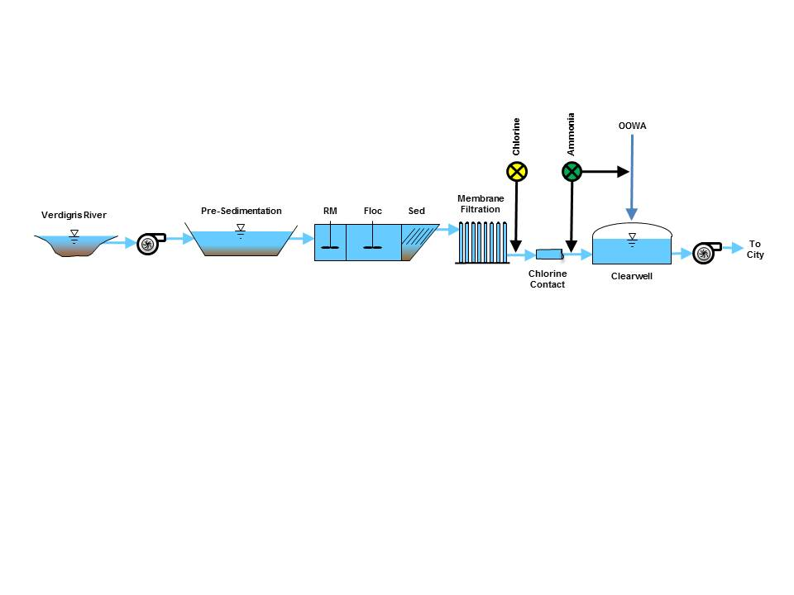
Water Supply System Overview

Slide 17
Chloramination
Part II
Secondary Disinfection:
Chloramination

Slide 18
Regulatory Agencies and Laws
Environmental Protection Agency (Federal)
Established through Executive Order by President Richard Nixon on December 2, 1970
Responsible to protect human health and safeguard the national environment.
Safe Drinking Water Act (1974) – Principle federal law intended to ensure safe drinking water for the public.
Code of Federal Regulations (CFR) – 40 CFR, Part 141/142
Title 40 – Protection of the Environment; Chapter I – Environmental Protection Agency; Subchapter D – Water Program; Part 141- Nation Primary Drinking Water Regulations: Disinfectants and Part 142 – National Primary Drinking Water Regulations – Disinfection Byproducts.

Slide 19
Regulatory Agencies and Laws
Department of Environmental Quality (State)
Established by State Statute, Title 27A, in 1993 under Governor David Walters.
Responsible to oversee, regulate and enforce the environmental policies of the State of Oklahoma.
Regulations established in Oklahoma Administrative Code (OAC), Title 252 – Department of Environmental Quality.
Specific Chapters of Interest include the following:
Chapter 626 – Public Water Supply Construction Standards;
Chapter 631 – Public Water Supply Operation.

Slide 20
Disinfection Regulations
Primary Disinfection Regulations
State of Oklahoma has been granted primacy with respect to water treatment processes, which includes primary disinfection process. Thus, Oklahoma Administrative Code (OAC) establishes appropriate regulations.
OAC Title 252:626-9-11(a)-1 states that “all surface water and ground water under direct influence of surface water supplies require disinfection.”
OAC Title 252:626-9-11(a)-3 states that a Public Water System cannot “make any changes to the disinfection process unless approved by the DEQ.”
OAC Title 252:626-9-11(c) states that “disinfection with chloramines is not appropriate for primary disinfection to meet CT [contact time] requirements.”

Slide 21
Disinfection Regulations
Secondary Disinfection Regulations
State of Oklahoma has not been granted primacy over secondary disinfection, so the federal government through the EPA oversees and enforces the regulations that relate to the distribution and storage portion of the water supply system.
CFR Title 40, Part 141, Section 72(b) states “each public water system that provides filtration treatment must provide disinfection treatment.”
CFR Title 40, Part 141, Section 74(a)(2) indicates that only Free Chlorine, Total Chlorine (may be measured as Combined Chlorine), Chlorine Dioxide and Ozone are acceptable disinfectants.”

Slide 22
Disinfection
Purpose of Disinfection
The purpose of the disinfection process is simply to inactivate the pathogenic waterborne microorganisms such as bacteria and viruses.
Secondary Disinfectants Approved by EPA
Chlorine (Cl)
Chloramine (NH₂Cl, NHCl₂, NCl₃)
Chlorine Dioxide (ClO₂)
Ozone (O₃)

Slide 23
Disinfection
Chlorination (Primary Disinfection)
Chlorination is the process of adding chlorine to water generally in one of the following forms in order to produce hypochlorous acid (HOCl) as the primary disinfectant at the treatment facility:
Chlorine Gas (Cl₂)
Cl₂ + H₂O → HOCl + H⁺ + Cl⁻
Sodium Hypochlorite (NaOCl)
NaOCl + H₂O → HOCl + NaOH
Calcium Hypochlorite (Ca(OCl)₂)
Ca(OCl)₂ + 2H₂O → 2HOCl + Ca(OH)₂

Slide 24
Disinfection
Chloramination (Secondary Disinfection)
Chloramination is the process of adding ammonia (NH₃) to water that contains a chlorinated disinfectant, generally in the form of hypochlorous acid (HOCl), in order to convert the chlorinated form of disinfectant to a chloraminated form of disinfectant:
Monochloramine
NH₃ + HOCl → NH₂Cl + H₂O
Dichloramine
NH₂Cl + HOCl → NHCl₂ + H₂O
Trichloramine
NHCl₂ + HOCl → NCl₃ + H₂O

Slide 25
Disinfection Byproducts
Disinfection Byproducts
Disinfection byproducts, commonly referred to as DBPs, are those chemical compounds that form as a secondary product (byproduct) with the disinfectant.
Presently, there are over 600 known DBPs.
It is crucial to understand that not all DBPs are harmful or potentially harmful to human health.
The EPA does recognize that certain specific DBPs are either (1) harmful or (2) may be harmful to human health.
For certain DBPs considered harmful or potentially harmful, the EPA has established a Maximum Contaminant Level (MCL) allowed in drinking water.
This MCL is scientifically related to the potential risk the specific contaminant MAY have upon human health.

Slide 26
Disinfection Byproducts
Regulated Disinfection Byproducts
In 1974, Trihalomethanes (THMs) were discovered in chlorinated drinking water and determined to be potentially harmful to human health.
In 1983, Haloacetic Acids (HAAs) were discovered in chlorinated drinking water and determined to be potentially harmful to human health.
The EPA immediately began to regulate THMs and HAAs in chlorinated drinking water by establishing a MCL for each.
Presently, the EPA regulates acceptable levels of disinfection byproducts within drinking water through the Stage 2 – Disinfection Byproduct Rule. This rule establishes a MCL for Bromate, Chlorite, Trihalomethanes and Haloacetic Acids.

Slide 27
Advantages/Disadvantages
Primary Advantages/Benefits of Chloramination
Chloramination is a proven secondary disinfection technique that has been practiced for nearly 100 years within the United States and Canada.
Significantly reduces the levels of chlorinated disinfection byproducts, which include: Bromate, Chlorite, Trihalomethanes and Haloacetic Acids.
More persistent and longer lasting residual disinfectant.
Reduction in chemical taste complaints (Monochloramines).
Reduction in odor complaints (Monochloramines).
Controls biofilm build up in the system.
Decrease in iron pipe corrosion.

Slide 28
Advantages/Disadvantages
Primary Disadvantages of Chloramination
Higher operational costs.
Potential for degradation of rubber products such as gaskets at the pipe joints.
Potential for increase in taste and odor problems (Dichloramines and Trichloramines).
Potential for increased corrosion in lead fittings and metal pipes.
Potential for increased levels of nitrogen-based disinfection byproducts such as Nitrosamines.
Potential for Nitrification within the distribution system.

Slide 29
Advantages/Disadvantages
Nitrogen-Based Disinfection Byproducts
Presently, the EPA does not regulate any Nitrogen-Based Disinfection Byproducts.
Nitrosamines are on the EPA “Contaminant Candidate List No. 3” for possible inclusion into federal regulations.
Current research indicates that essentially all nitrosamine formation during chloramination could be attributed to the traces of dichloramine present in solution (Australian Water Association).
Addition of Ammonia shortly after the addition of Chlorine for primary disinfection may reduce the potential for Nitrosamine formation while maintaining the reduction chlorinated disinfection byproducts.

Slide 30
Advantages/Disadvantages
Nitrification
Nitrification is the conversion of Ammonia (NH₃) to Nitrite (NO₂⁻) and then the subsequent conversion of Nitrite (NO₂⁻) to Nitrate (NO₃⁻²).
Nitrification may occur within a water distribution system where increased oxygen levels persist, such as in a storage tank.
Nitrification may lead to decreased water quality within a distribution system if left unchecked.
Nitrification may be controlled through a detailed monitoring and maintenance program.

Slide 31
Questions and Answers
Why change?
Monochloramines are a longer lasting residual disinfectant that can reach the extremities of our distribution system while maintaining the minimum residual requirement.
Monochloramines enable us to meet federal regulations on disinfection byproducts such as Trihalomethanes and Haloacetic Acids.
Monochloramines reduce chemical taste and odor problems.
Are monochloramines safe?
Yes, the Environmental Protection Agency (EPA), American Water Works Association (AWWA), World Health Organization (WHO), Center for Disease Control (CDC) all recognize chloramines as a safe and effective secondary disinfectant.

Slide 32
Questions and Answers
Are there disinfection byproducts?
Yes, there are some known disinfection byproducts from chloramination.
At present time, no disinfection byproducts are regulated by the federal or state government.
In the near future, we anticipate that the federal and state government will regulate the maximum contaminant level of specification nitrosamines in drinking water.
Are there any special considerations?
Yes, kidney dialysis patients/treatment centers must neutralize the ammonia prior to use.
Aquarium owners/ merchants must neutralize the ammonia prior to use.

Slide 33
Questions and Answers
Are monochloramines harmful to household products?
EPA research indicates that chloramines are not harmful to household products such as humidifiers, ice makers, washers, toilets, swimming pools, etcs.
Do monochloramines cause cancer?
EPA indicates that drinking water disinfected with monochloramines in accordance with regulatory standards poses no known or anticipated adverse health effects including cancer.
In fact, EPA data indicates that monochloramine use may reduce the risk of certain types of cancers compared to chlorination.

Slide 34
Questions and Answers
Do monochloramines cause skin problems?
EPA’s research indicates that drinking water disinfected with monochloramines in accordance with regulatory standards has no known or anticipated adverse health effects including skin problems.
Isolated cases of skin problems due to chloramine exposure have been reported; however, EPA indicates that monochloramine has not been shown to be a contributor.
CDC independent investigations concerning reports of mononchloramine-related skin problems have not been conclusive.

Slide 35
Questions and Answers
Do monochloramines cause digestive problems?
EPA’s research indicates that drinking water disinfected with monochloramines in accordance with regulatory standards has no known or anticipated adverse health effects including digestive problems.
In fact, the amount of mononchloramines ingested from drinking water is broken down quickly by saliva, neutralized by stomach acid and leaves the body through human waste production.
Do monochloramines cause breathing problems?
EPA’s research indicates that drinking water disinfected with monochloramines in accordance with regulatory standards has no known or anticipated adverse health effects including breathing problems.
CDC independent investigations with respect to breathing problems reported due to chloramines have been inconclusive.

Slide 36
Conclusions
Final Thoughts
The City of Broken Arrow is committed to treating and supplying safe drinking water that meets or exceeds the minimum regulatory standards established by the Safe Drinking Water Act and enforced by federal and state agencies.
The new water treatment facility with state of the art membrane filtration technology and the subsequent conversion from chlorination to monochloramination as a secondary disinfectant technique is one example of this commitment.
The EPA, DEQ, AWWA , CDC and WHO as well as other worldwide governmental agencies recognize the advantages and benefits of monochloramines as a secondary disinfectant technique operated in accordance to federal and state regulations.

Slide 37
Conclusions
The City of Broken Arrow is converting from chlorination to mononchloramines for secondary disinfection in order to better maintain a more persistent and longer lasting residual in our distribution system as well as reduce the disinfection byproducts associated with chlorination.
Once the chloramination techniques is implemented, the City Water and Health Professionals will continue to monitor and manage the treatment process, distribution and storage systems in order to reduce the potential of nitrification and the formation of nitrogen-based byproducts.

Slide 38
Contact Information
For additional information, comments or to report concerns, the direct point of contact for the City of Broken Arrow is:
Ms. Stephanie Higgins
Director of Communications
220 S. First Street
Broken Arrow, OK 74013
(918) 893-6800
watersupply@brokenarrowok.gov

